Slide 1

CS302 Design and Analysis of Algorithms
Muhammad sohail afzal

Slide 2
Graphs – Prims algorithm for MST
Prims algorithm Steps for finding MST :
Randomly select first vertex
Now check all the edges adjacent/connected to first selected vertex and update weights of connected vertices.
Select that edge which has minimum cost among all connected edges.
Now this selected edge has two vertices. Check all the edges connected to these two vertices and select minimum.
Then it will have three vertices. Select minimum edge among edges connected to these three vertices and so on
At the end, you will get minimum spanning tree. Sum the cost of all edges that will be the minimum spanning tree cost.

Slide 3
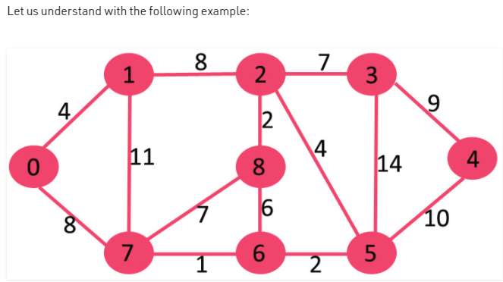
Graphs – Prims Example

Slide 4
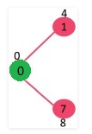
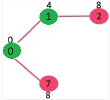
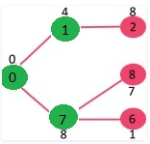
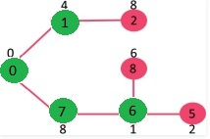
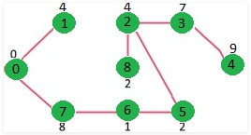
Graphs – Prims Example
This process goes on and at the end you get below minimum spanning tree :

Slide 5
Graphs : Prims algorithm Example 2
Now another Example of prims algorithm in next slide that will show you how prims work actually using minimum priority queue

Slide 6
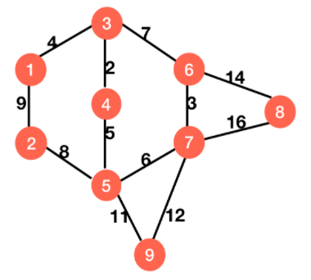
Graphs – Prims Example 2 (Internal working in detail )
We will see complete working of prims in detail (with minimum priority queue) through another example given below

Slide 7
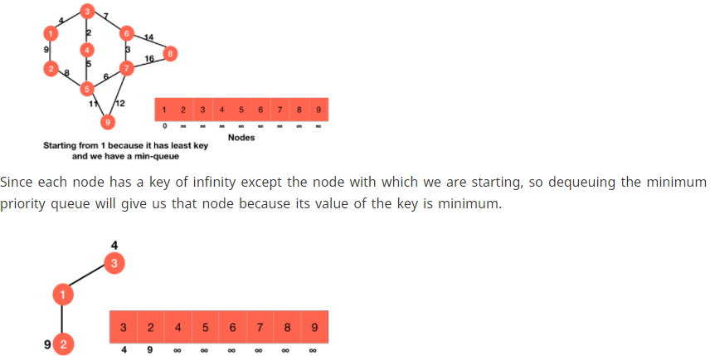
Graphs – Prims Example 2 (Internal working in detail)

Slide 8
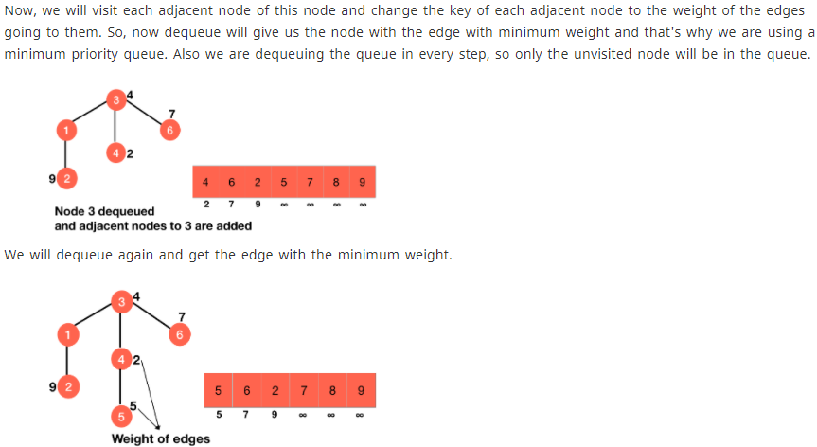
Graphs – Prims Example 2 (Internal working in detail)

Slide 9
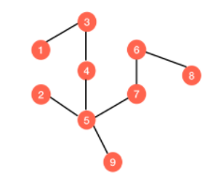
Graphs – Prims Example 2 (Internal working in detail)
And this goes on and on till you get this minimum spanning tree after traversing through all the vertices of priority queue :

Slide 10
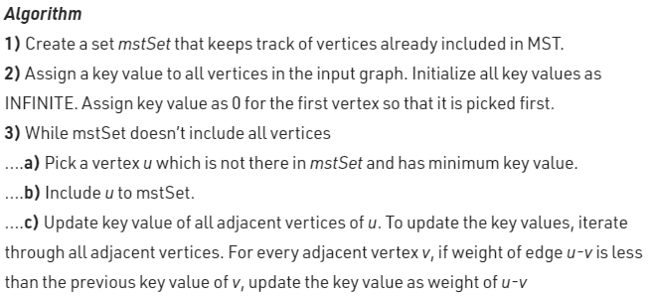
Graphs – Prims algorithm pseudo code
Correction* : In above prims algorithm, u-v in second last line stands for “u to v edge” and not “u minus v”

Slide 11
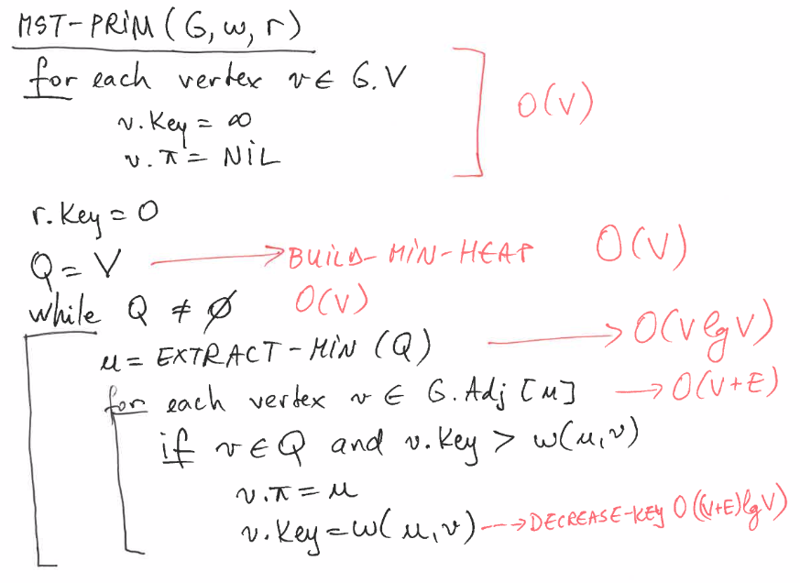
Graphs – Prims algorithm pseudo code
The time complexity is O(VlogV + ElogV) = O(ElogV), making it the same as Kruskal's algorithm.

Slide 12
Kruskal & Prims – Greedy algorithms
Kruskal algorithm is greedy algorithm because we choose to union two set of vertices each step according to the minimal weight available, we choose edge that looks optimal at the moment. This is greedy step and thus the algorithm is said to be greedy
Prim's Algorithm is also greedy in the sense that it reorders its input in order to choose the cheapest connected edge every time

